Slide 1


Static Routing in the Modern
Network

Slide 2


Table of Contents
Points for discussion:
Introduction to Static Routing
Static Route Components
Virtual Representation of Static Routes
Configuration of Static Routing
Types of Static Routes
Advantages of Static Routing
Disadvantages of Static Routing
When to use Static Routing
Comparison of Static Routing vs Dynamic Routing
Conclusion

Slide 3
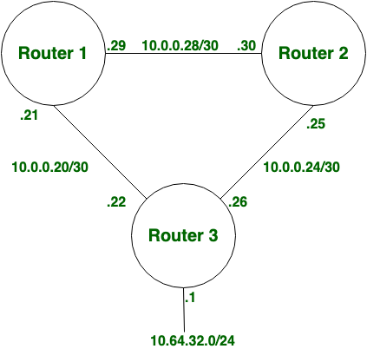
Introduction to Static Routing
Static Routing is also known as non-adaptive routing which doesn’t change the routing table unless the network administrator changes or modifies them manually.
It is configured by Administrator manually.
Mandatory need of Destination Network ID.
It is secure and fast.
It is used for small organizations with a network of 10-15
routers.
It generally acts as an alternative to dynamic routing to provide the failsafe backup if the dynamic routes are not accessible.
Administrative distance for Static Route is either 0 or 1.

Slide 4

COMPONENTS OF STATIC ROUTING
Destination Network/Subnet:
Specifies the target network using an IP address and subnet mask (e.g., 192.168.1.0/24).
Subnet mask defines the network portion of the IP address.
Next Hop:
IP address of the first router on the path towards the destination (e.g., 10.0.0.1).
Packets are forwarded to this router for further delivery.
Administrative Distance:
Value (lower preferred) used to choose the best path if multiple routes exist (not always used).

Slide 5
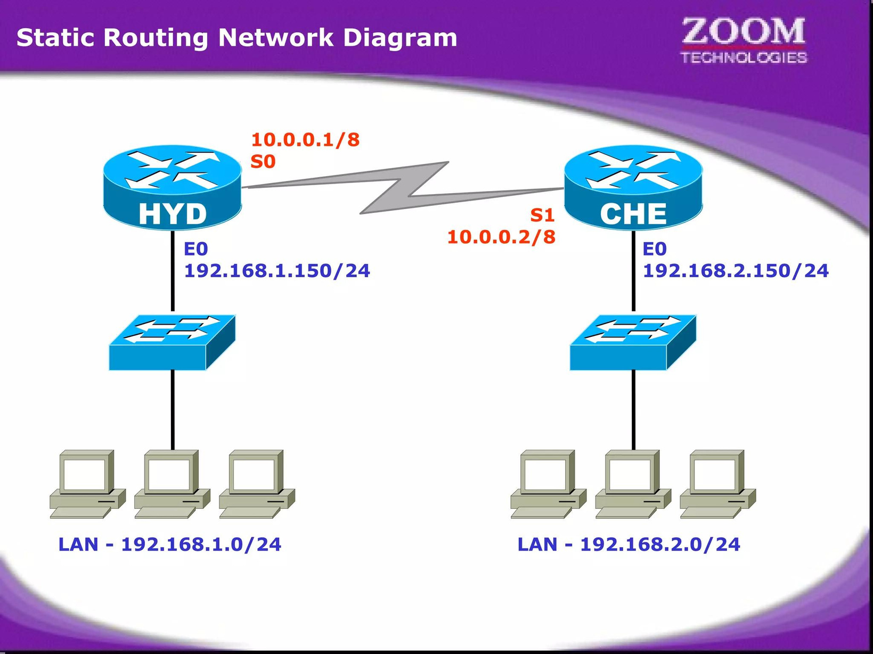
VISUAL REPRESENTATION OF STATIC ROUTING

Slide 6
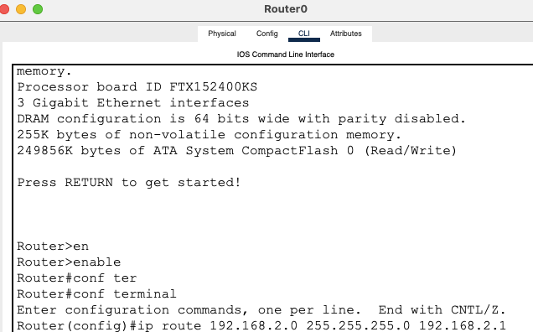
CONFIGURATION OF STATIC ROUTING

Slide 7
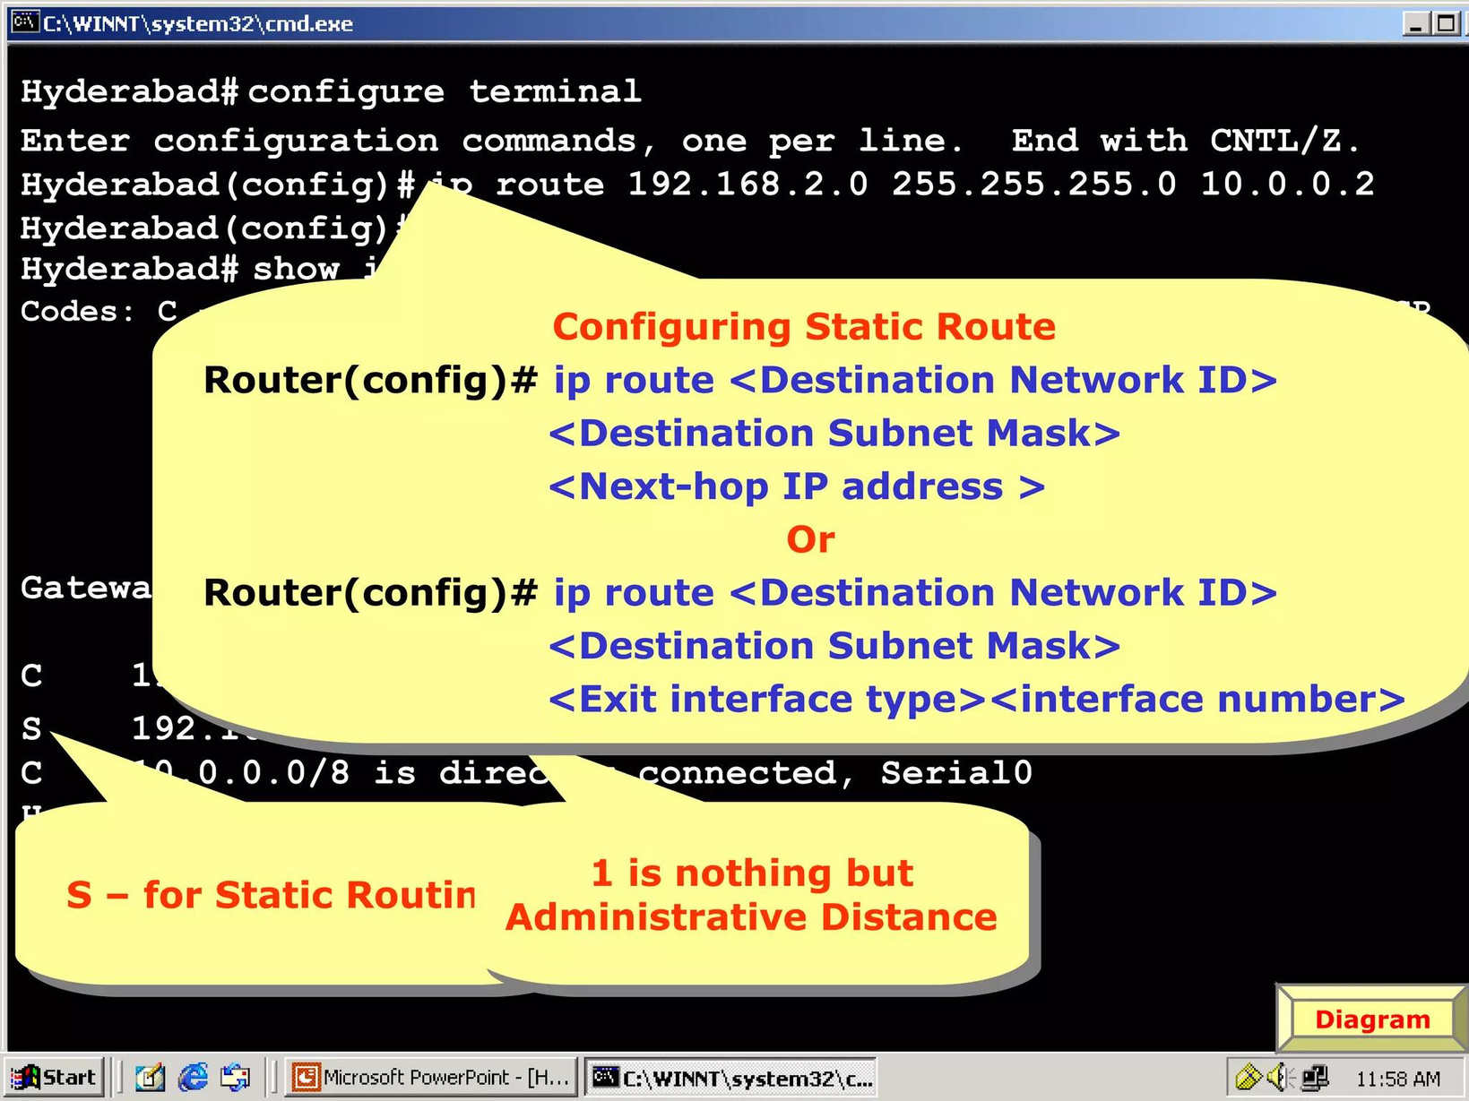

Slide 8
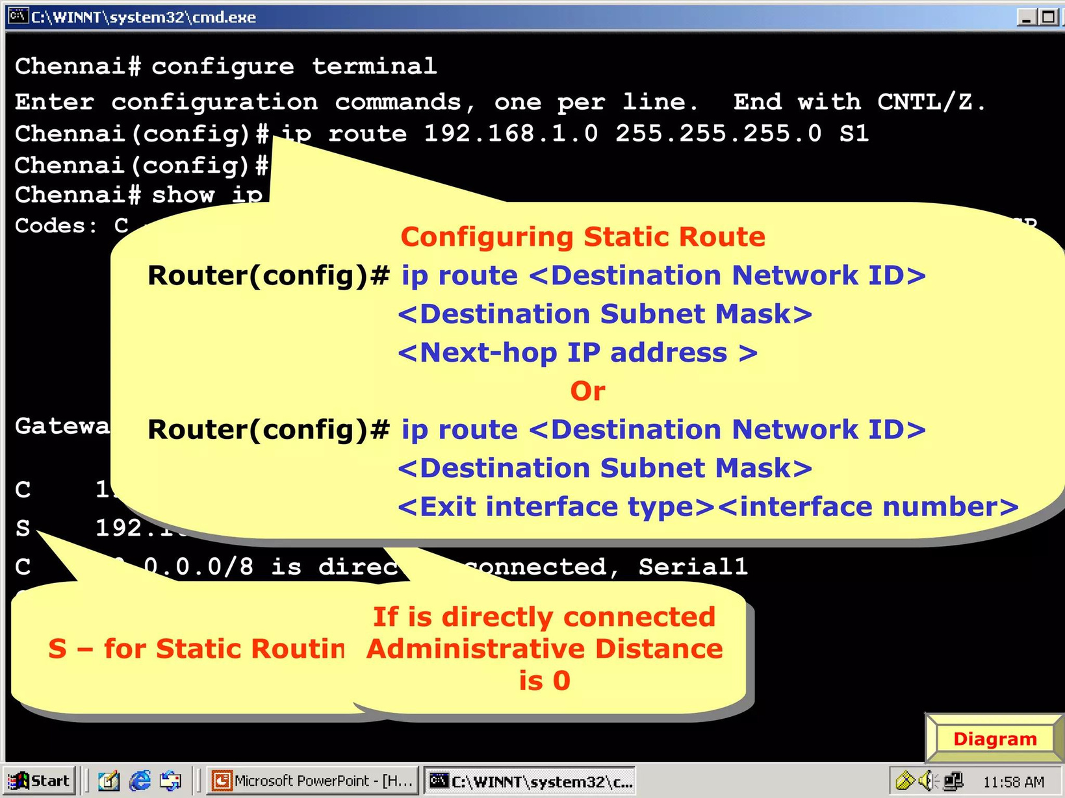

Slide 9
TYPES OF STATIC ROUTING
Standard Static Routes: Manually configured routes specifying the exact path for traffic to follow.
Default Static Routes: A route used when no other routes match the destination IP address; typically directs traffic to the internet.
Floating Static Routes: Backup routes with a higher administrative distance than primary routes, activated only if the primary route fails.
Summary Static Routes: Combines multiple routes into a single route to simplify the routing table and conserve resources.
Recursive Static Routes: Routes that use the next hop IP address not directly connected to the router, requiring an additional lookup.
Host Static Routes: Specifies a route to a single host (specific IP address) rather than an entire network.

Slide 10
BENEFITS OF STATIC ROUTING
Simple & Easy Management: Ideal for small networks, requiring minimal configuration.
Predictable & Reliable Routing: Predefined paths ensure consistent traffic flow.
Granular Traffic Control: Administrators have full control over packet paths.
Lower Processing Overhead: Requires minimal resources compared to dynamic routing.
Deterministic Behavior: No unexpected changes in routing paths.
Cost-Effective (Small Networks): No need for complex software or additional hardware.

Slide 11
LIMITATIONS OF STATIC ROUTING
Limited Scalability: Difficult to manage for large or changing networks.
Lacks Adaptability: Doesn't automatically adjust to network changes.
Increased Burden: Managing many static routes becomes time-consuming.
Prone to Errors: Manual configuration can lead to network issues.
Loop Potential: Requires careful planning to avoid disrupting traffic.
Not for Dynamic Environments: Less suited for networks with frequent changes.

Slide 12
STATIC ROUTING VS DYNAMIC ROUTING
Static Routing | Dynamic Routing
In static routing routes are user-defined. | In dynamic routing, routes are updated according to the topology.
Static routing does not use complex routing algorithms. | Dynamic routing uses complex routing algorithms.
Static routing provides high or more security. | Dynamic routing provides less security.
Static routing is manual. | Dynamic routing is automated.
Static routing is implemented in small networks. | Dynamic routing is implemented in large networks.
In static routing, additional resources are not required. | In dynamic routing, additional resources are required.
In static routing, failure of the link disrupts the rerouting. | In dynamic routing, failure of the link does not interrupt the rerouting.
Less Bandwidth is required in Static Routing. | More Bandwidth is required in Dynamic Routing.
Static Routing is difficult to configure. | Dynamic Routing is easy to configure.
Another name for static routing is non-adaptive routing. | Another name for dynamic routing is adaptive routing.

Slide 13
ANY QUERIES ?
ANY COMMENTS ?
ANY SUGGESTIONS ?

